Slide 1

Forecast and evaluation of high aerosol events using Global Forecast model at NOAA/National Weather Service
Partha S. Bhattacharjee¹, Li Zhang^{2,3}, Georg A. Grell³, Li Pan¹, B. Baker^{4,5,6}, Jeff McQueen⁷, Rick Saylor⁴, G. Frost⁸ and I. Stajner⁷
¹ I.M Systems Group at NCEP/NWS/EMC, College Park, MD, ² CIRES, Univ. of Colorado, CO, ³ Global Systems Division, ESRL NOAA, Boulder, CO, ⁴ NOAA ARL, College Park, MD, ⁵ UMBC JCET Baltimore, MD, ⁶ UMCP CISSESS, College Park, MD,
⁷ Environmental Modeling Centre, NCEP NOAA, College Park, MD, ⁸ Chemical Science Division, ESRL NOAA, Boulder, CO

Slide 2
Towards replacing GFS based NGACv2 with GEFS based system
Current work is collaboration between NOAA-ESRL/GSD & NWS/EMC
FV3GFS was coupled to a NUOPC chemistry component (the WRF-Chem chem_driver) and using simple bulk aerosol modules from the Goddard Chemistry Aerosol Radiation and Transport (GOCART) aerosol module. The dust module was replaced with FENGSHA and a 1-d wind shear dependent cloud model was used to determine injection heights from biomass burning region.
Impacts of different fire emissions (MODIS, GBBEPx) and plume rise application were extensively evaluated against observation before finalizing the final configuration.
It will be placed as a member in the Global Ensemble Forecast System (GEFS) version 12 and named as GEFS-Aerosols.
GEFS-Aerosols slated to replace current operational NEMS GFS Aerosol Component (NGACv2) in late summer 2020.

Slide 3
Salient features of GEFS-Aerosols in GEFS v12
Resolution: c384 (~25km horizontal resolution) L64 to 5 days, 6-hourly global forecast and 4x/day (00, 06, 12 and 18)
Meteorology : GEFS, based on GFSv15
Aerosol : Inline aerosol representation based on GOCART (Dust, Organic and Black carbon, Sea-salt, Sulfate)
Transport:
Sub-grid scale tracer convective transport and wet scavenging included in GFS-Physics - SAS scheme and planetary boundary layer (PBL)
Fluxes are calculated positive definite
Deposition:
Wet deposition (for aerosols and sulfate) and dry deposition (all species)
Anthropogenic Emissions: CEDS-2014 (SO₂, PSO₄, POC, PEC)
Biomass burning: NESDIS Global Biomass Burning Emission Product (GBBEPx) used for fire size and location (Zhang et al., 2012); 1d wind shear-dependent cloud model used to simulate plume tilt and Fire Radiative Power (FRP) is used to determine injection heights and emission rates online
Dust: 5 size bins
FENGSHA dust scheme: scheme used in current NAQFC (Tong et al. 2016)
Sea-salt: NASA GEOS-5 GOCART
Marine Dimethyl Sulfide: GOCART with monthly values as in Lana et al. (2011)
Chemistry cycled for initial conditions, but GFSv15 analysis for meteorology

Slide 4
GEFS-Aerosols Products
GEFS-Aerosols provides 0.25, 0.5 and 1x1 degree forecast products in GRIB2 format 4 times per day
Product files and their contents include:
2d fields : Aerosol Optical Depth (AOD) at 340, 440, 550, 660, 860, 1063 and 1110nm from 0-120 hours
PM10 and PM2.5 for 0-120 hours.
Total AOD at 550nm contains fields from all 5 species (dust, sea-salt, carbonaceous aerosols, sulfate AOD) along with emission, sedimentation, dry deposition and wet deposition fluxes.
Single scatter albedo and asymmetric factor for total aerosols at 340nm
3d fields : Aerosol mixing ratios of species at model levels along with pressure, temperature and RH.
results from daily model forecasts between July – December, 2019
AOD at 550nm used for verification with observation

Slide 5
Verification Dataset
6-hourly AOD forecast from International Cooperative for Aerosol Prediction Multi-model Ensemble (ICAP-MME) (Peng et al., 2019) – ICAP uses data assimilation
AOD analysis from MERRA2 (Randles et al., 2017)
Daily MODIS total AOD from collection 6.1 - combined dark target and deep blue (DT and DB)
Daily VIIRS AOD at 0.25x0.25 degree
Total AOD from AERONET station data – Version 3, level 1.5

Slide 6
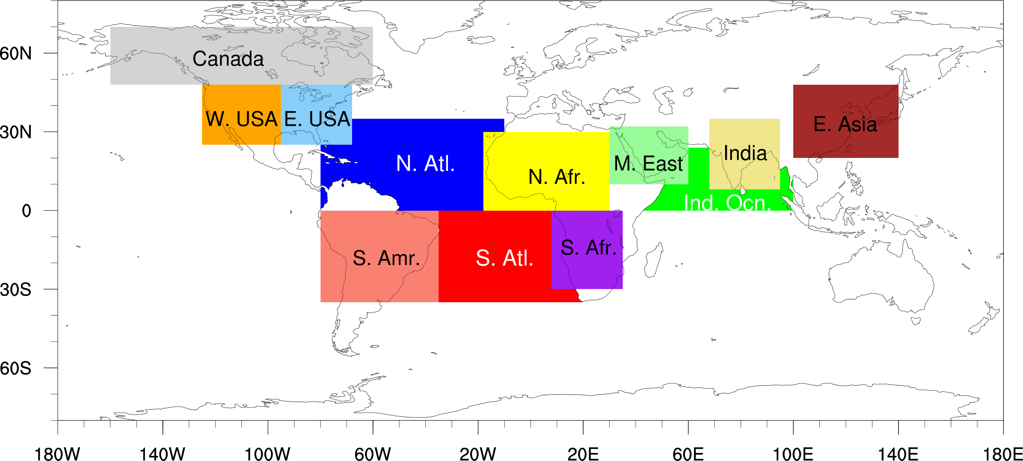
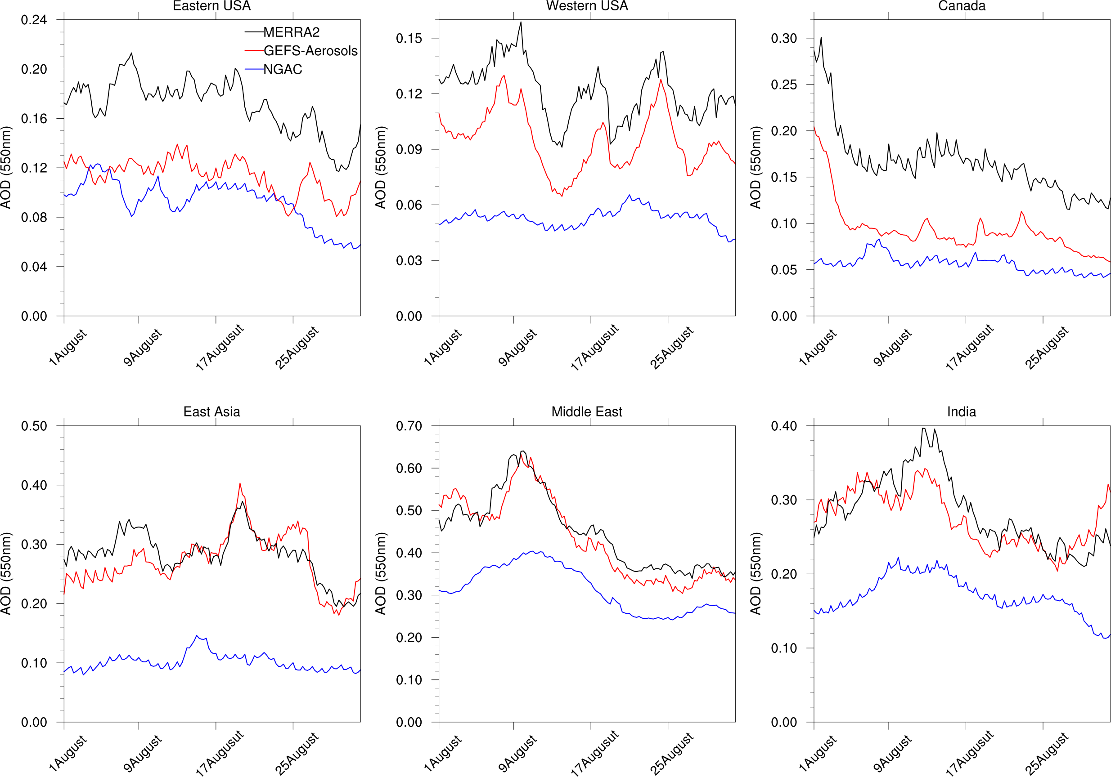
Day 1 total AOD forecast time series against reanalysis : August, 2019
GEFS-Aerosols show major improvement over anthropogenic pollution regions

Slide 7
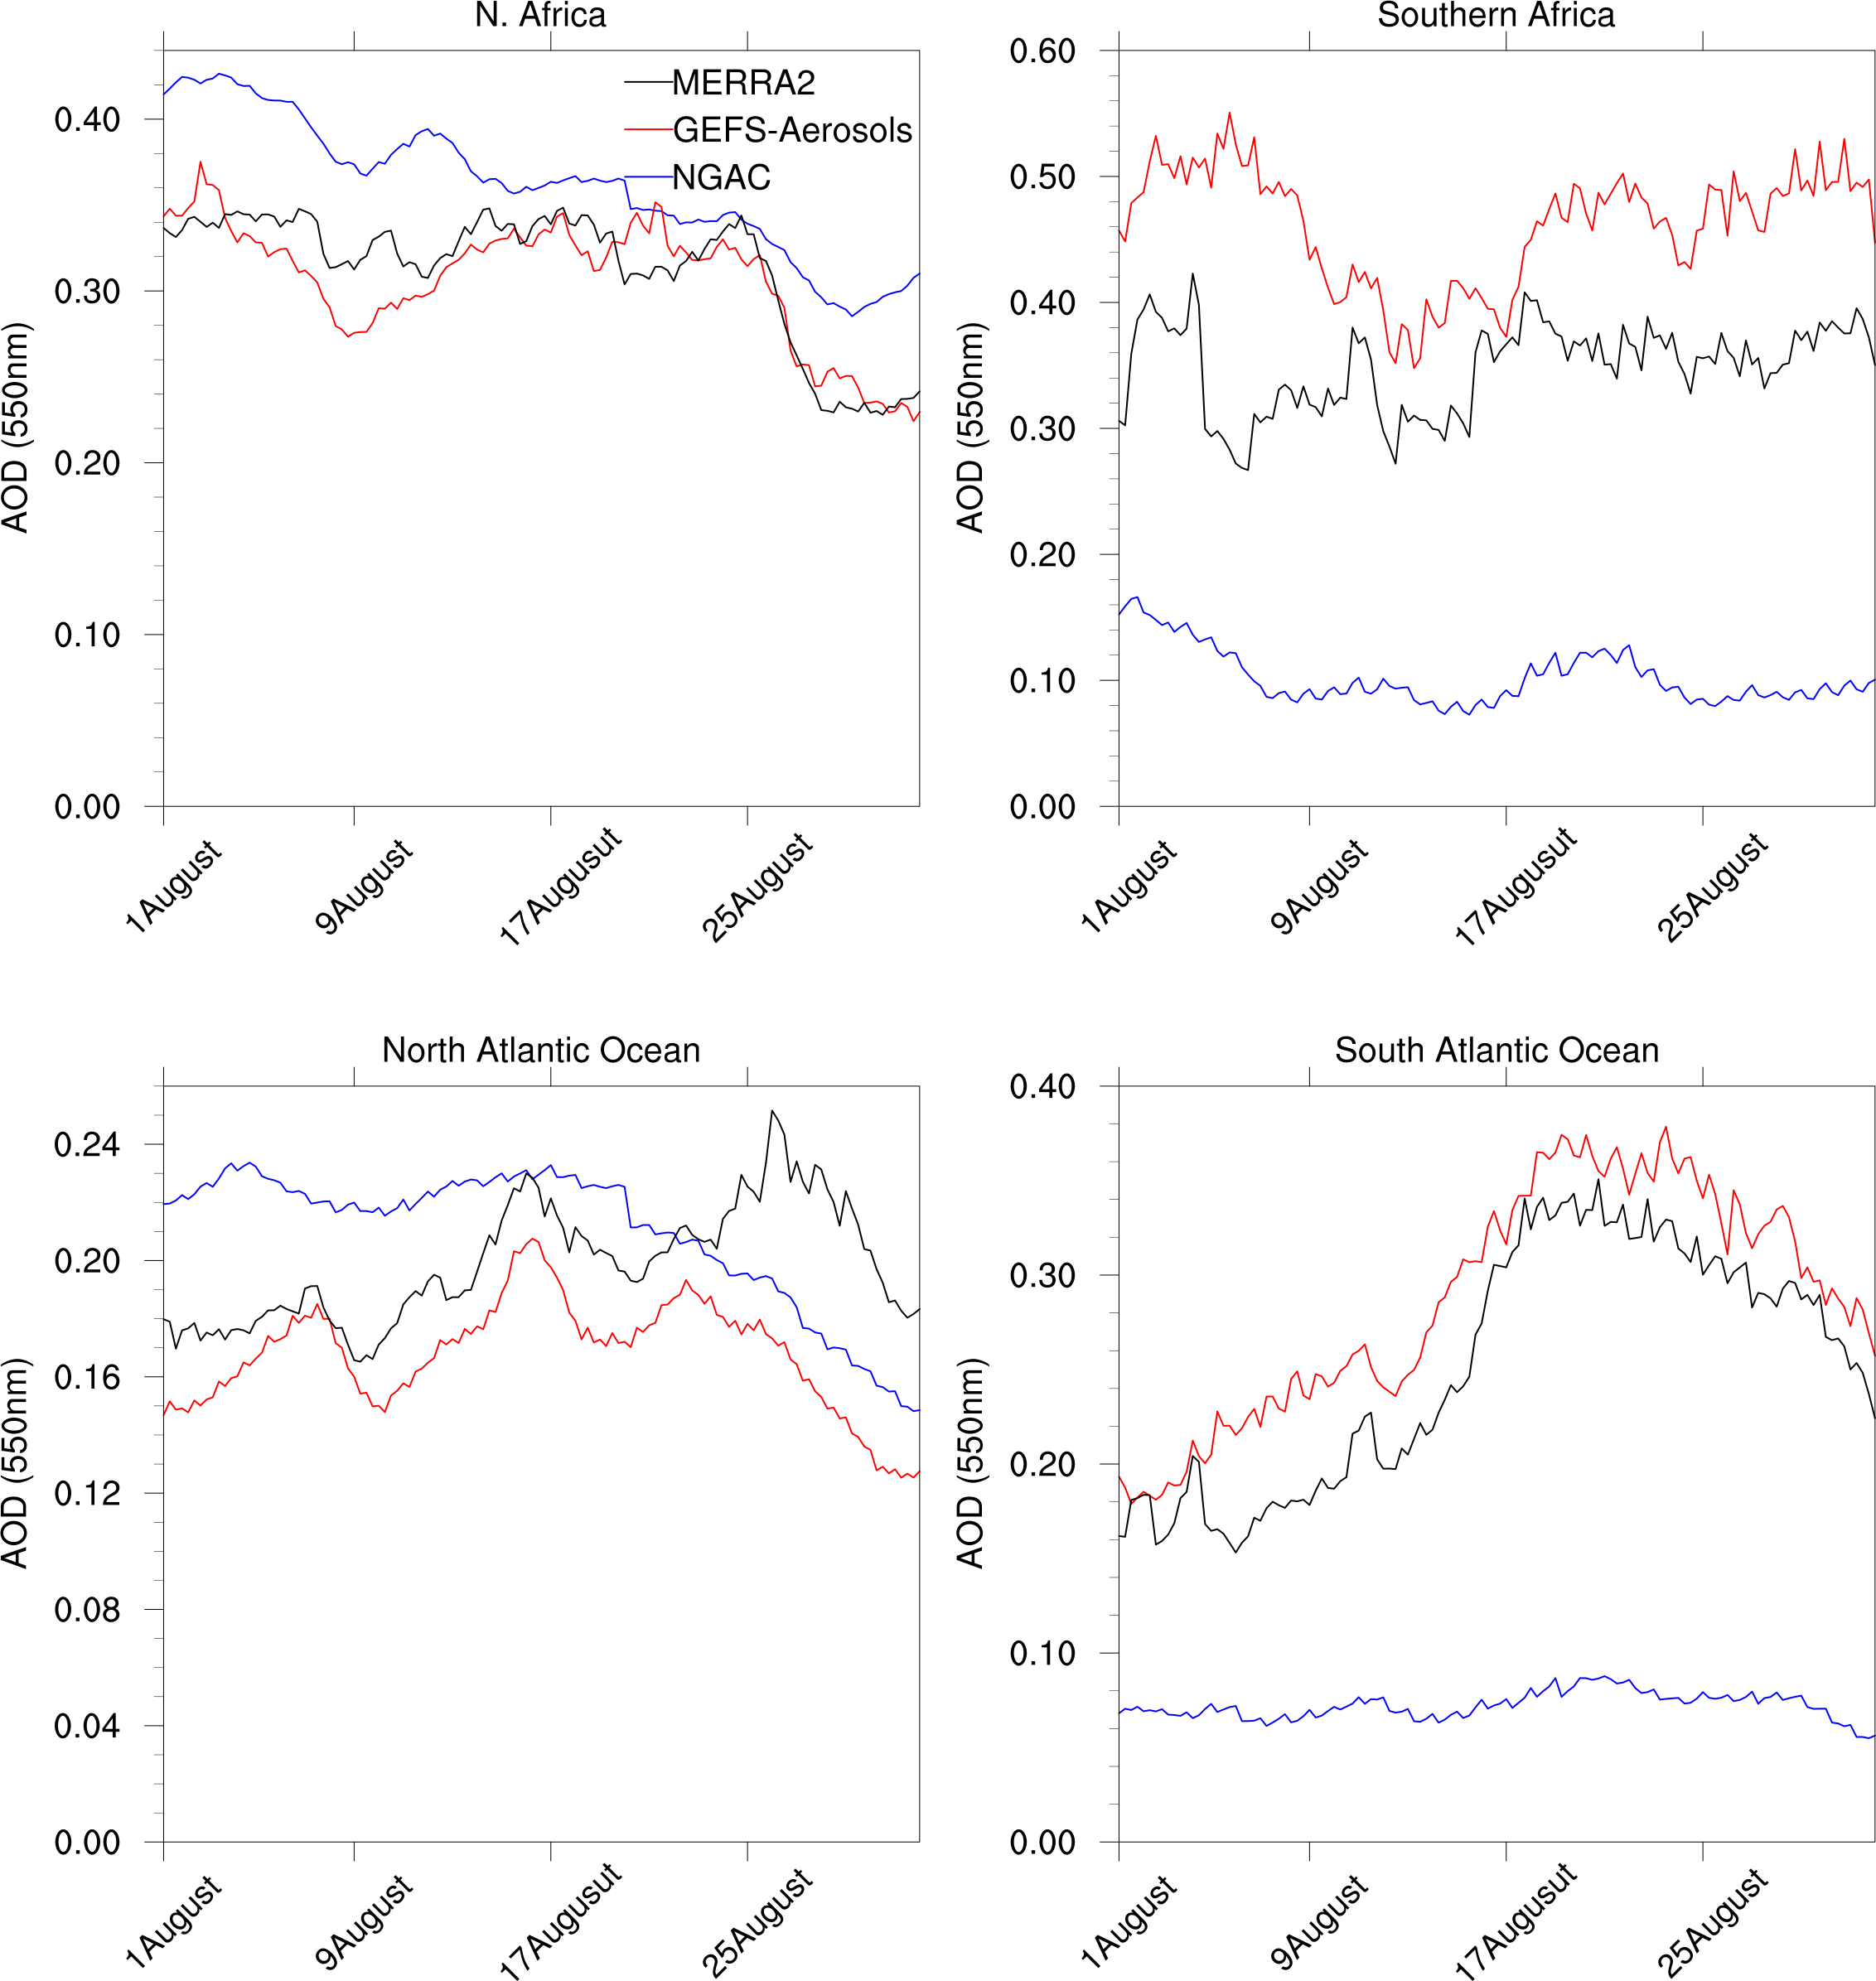
Day 1 total AOD forecast time series against reanalysis : August, 2019
Saharan dust dominates AOD over N. Africa and NGACv2 over predicts dust around the source region
Transport of OC/BC/Sulfate from African wildfire (S. Atlantic Ocean) is well captured by GEFS-Aerosols. However, it over predicts over wildfire source region in land (Southern Africa)

Slide 8
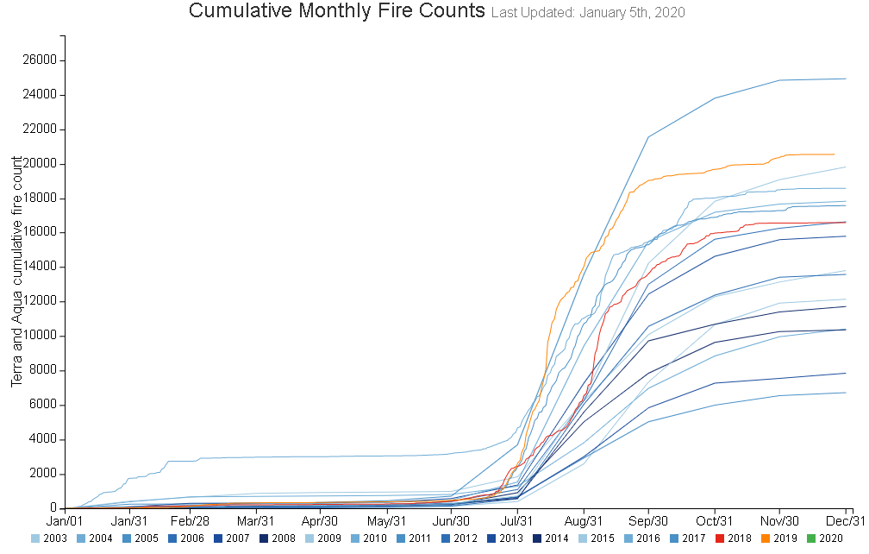
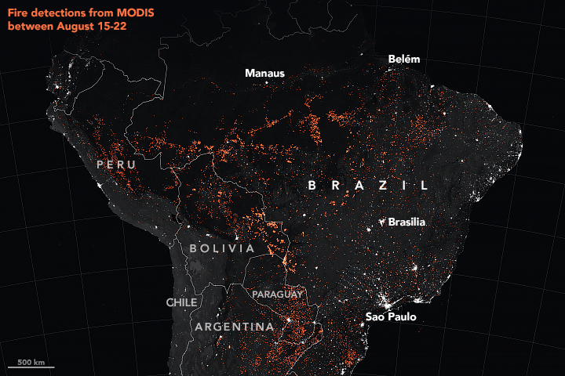
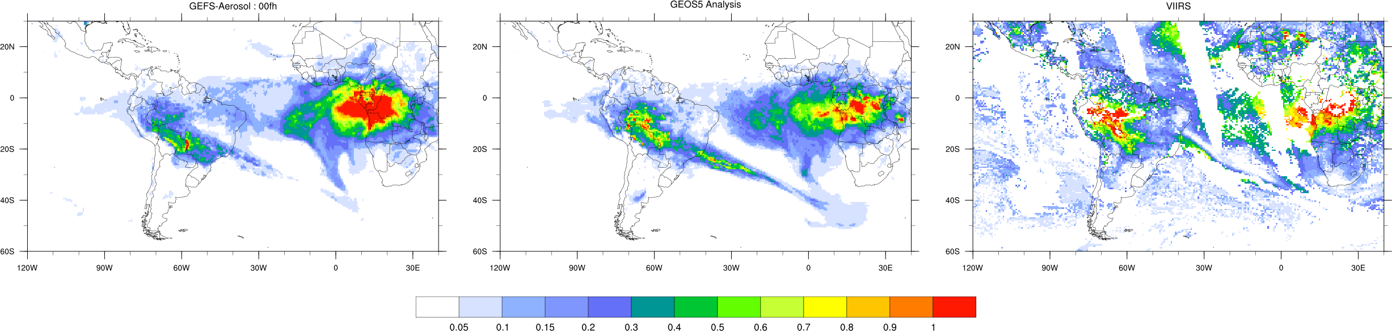
High aerosol event : Wildfire in Amazon, 2019
Extensive number of fires raged throughout Brazil in 2019, intensifying in August – drought stressed forest fueled Amazon fire
Global Fire Emission Database (GEFD)
over Central Amazon region
2019
Organic Carbon (OC) AOD : 21st August
OC AOD
OC AOD
Total AOD

Slide 9
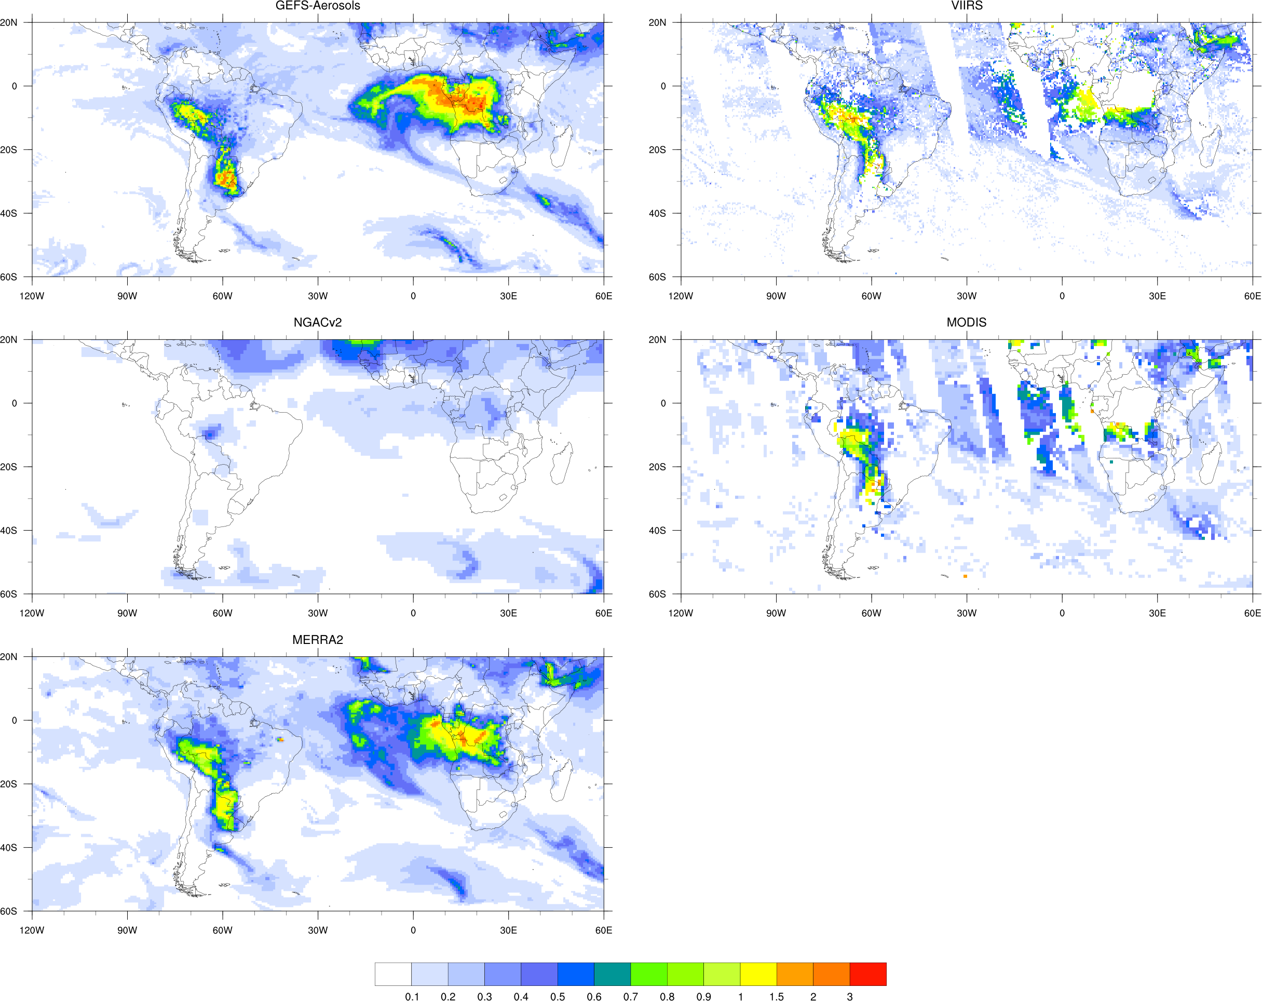
Amazon fire
24-hour total AOD forecast on 25th August verified
against observations – largely missed in NGACv2

Slide 10
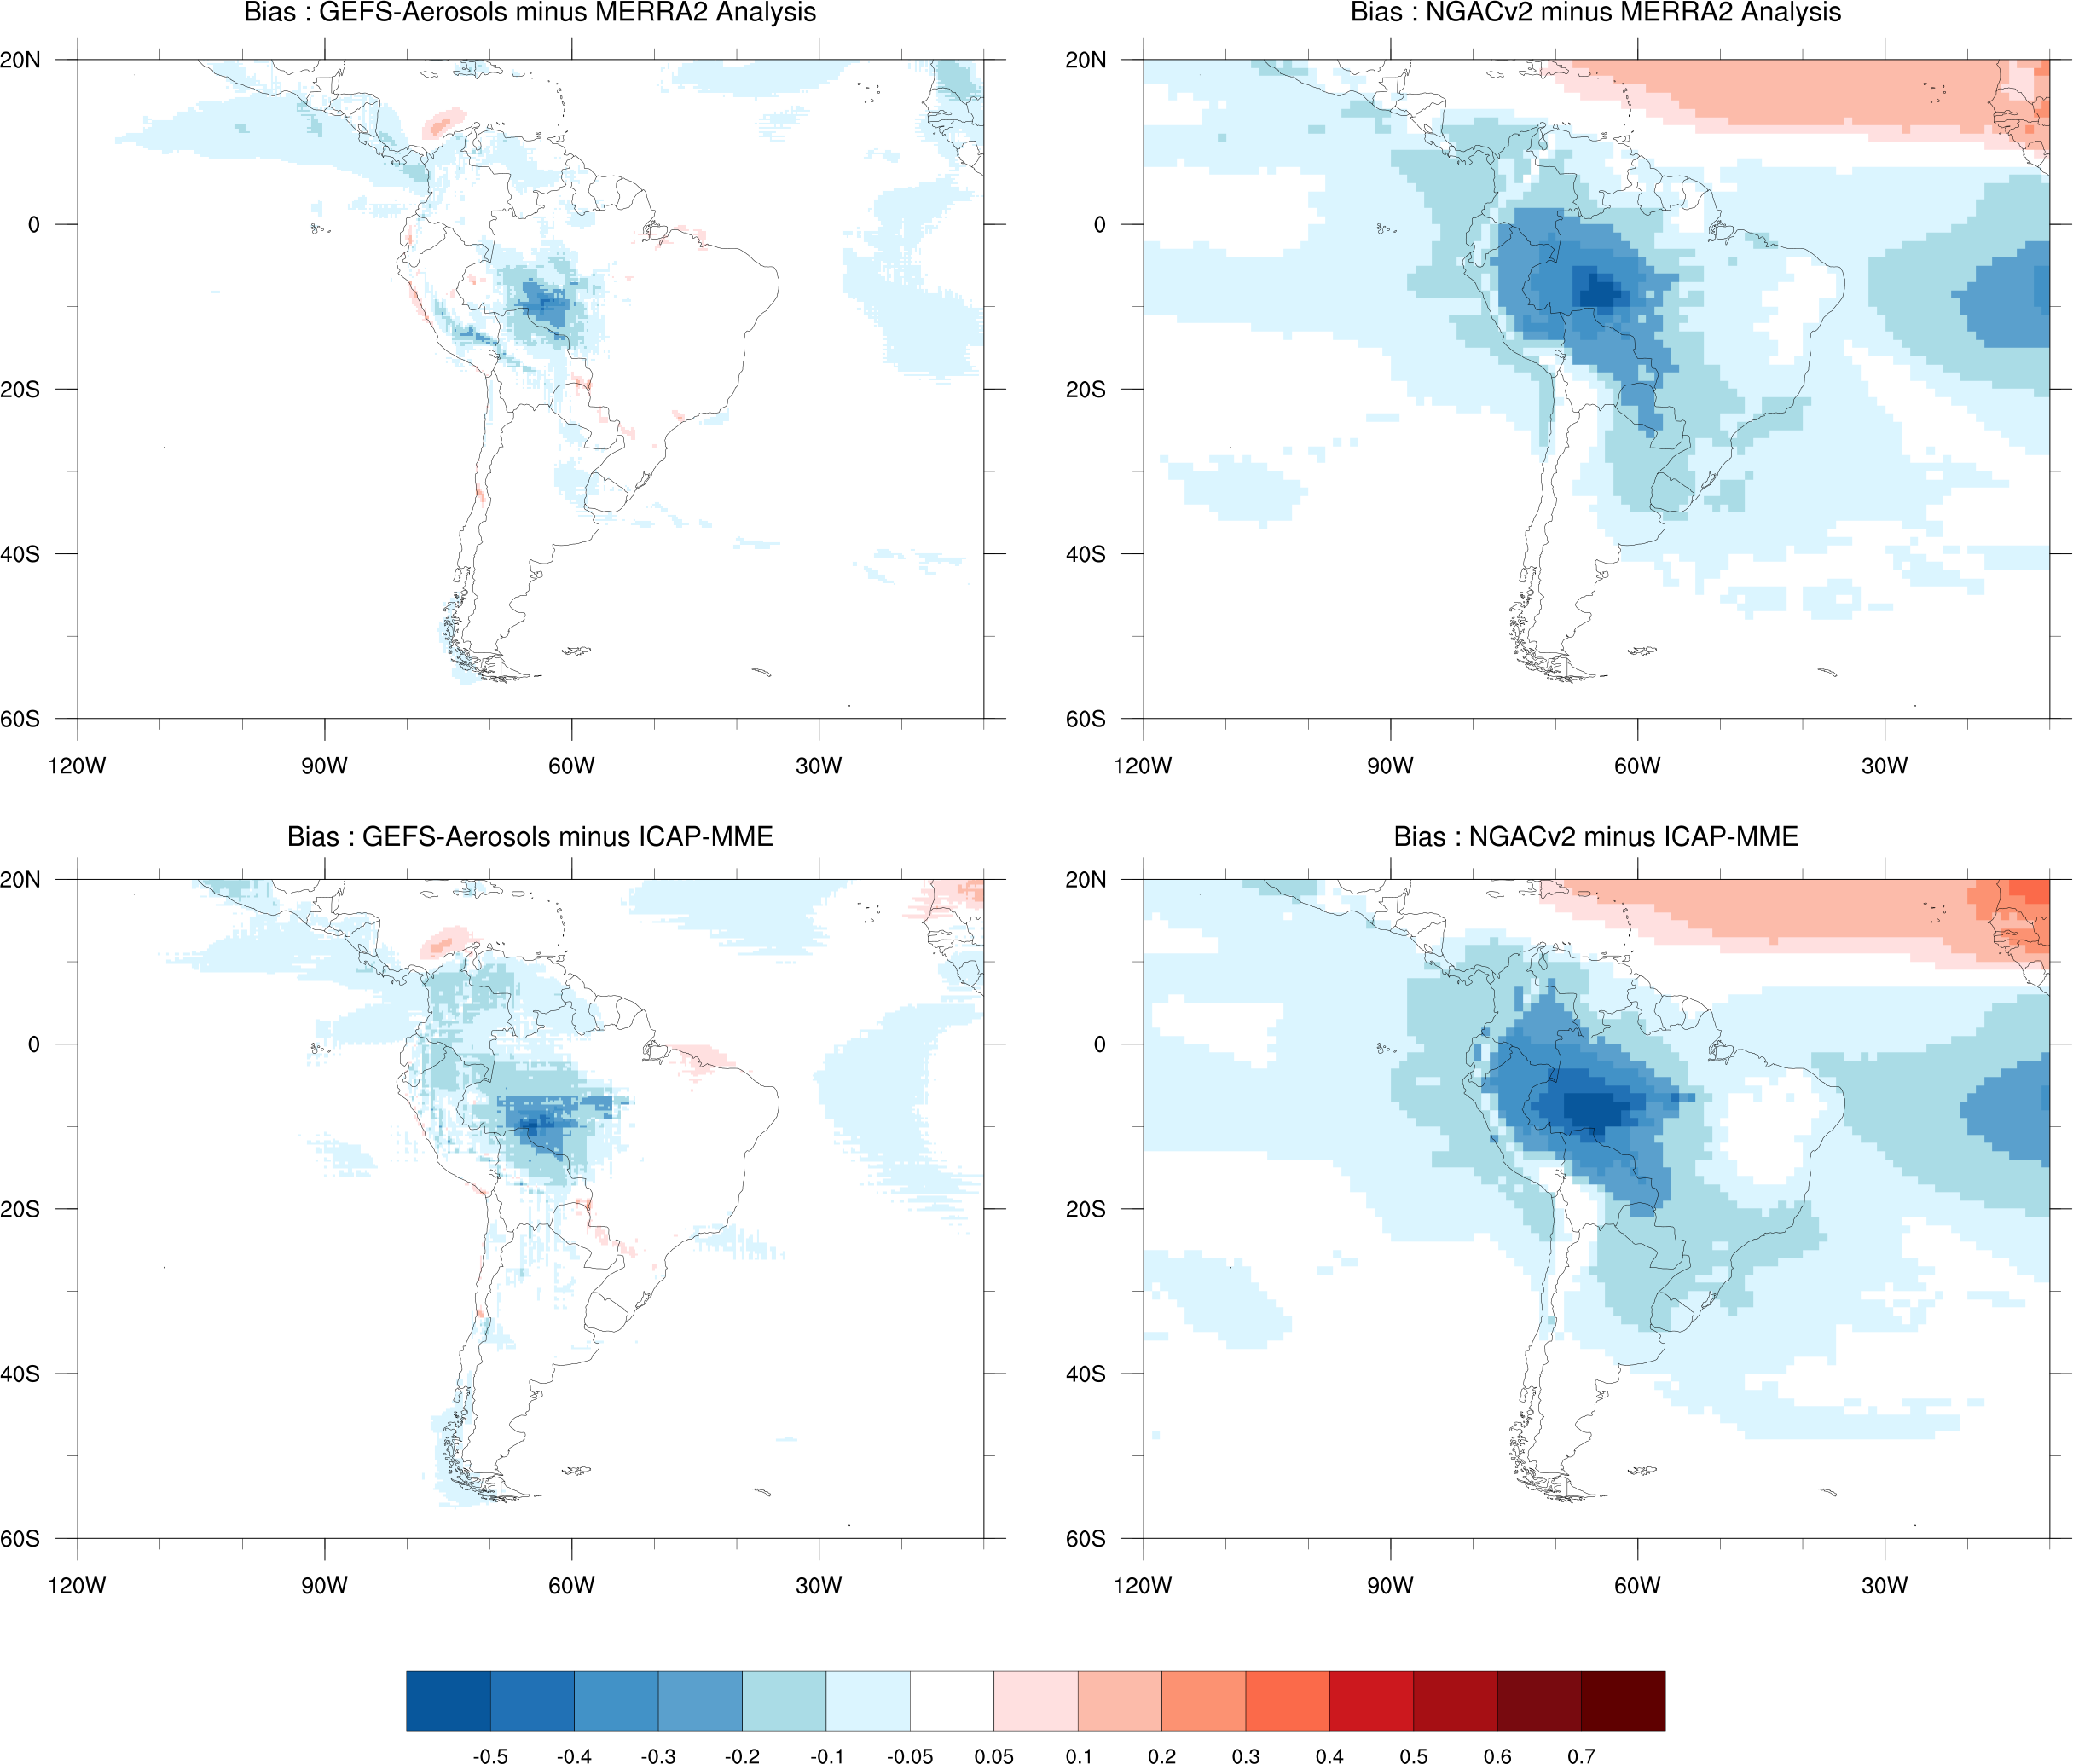
Day 1 total AOD forecast bias for August, 2019
GEFS-Aerosols show less bias in Total AOD prediction when compared against two different data set

Slide 11
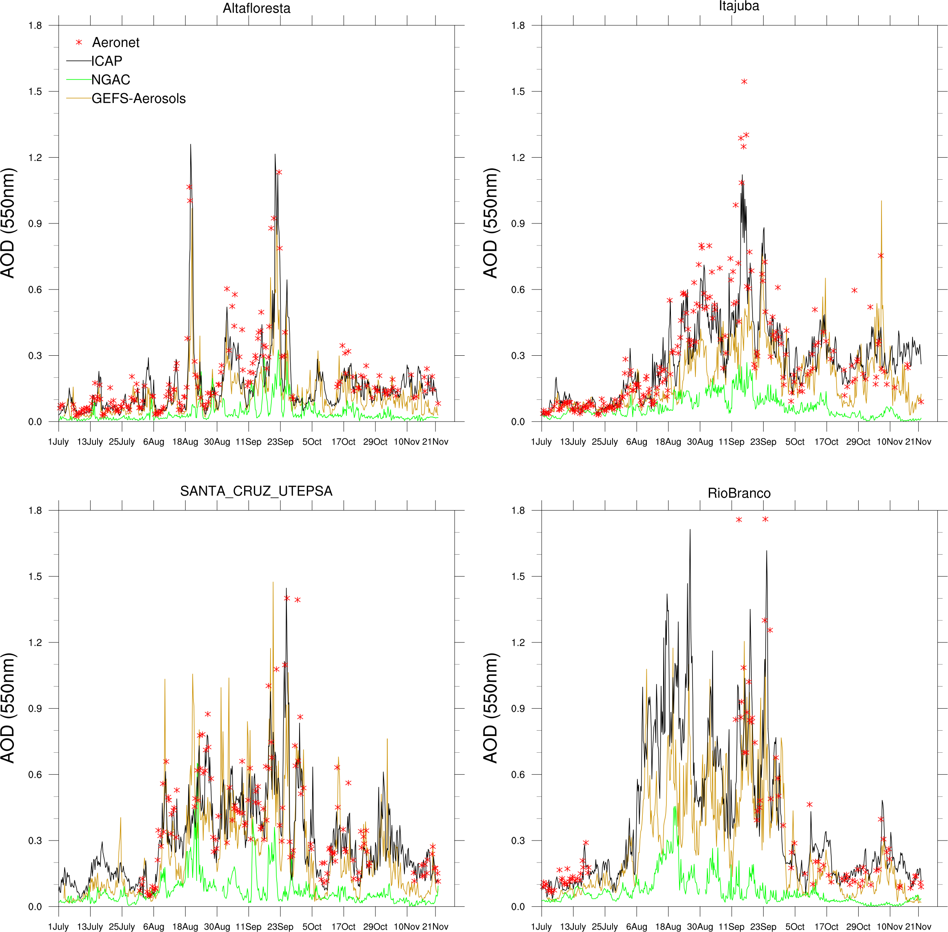
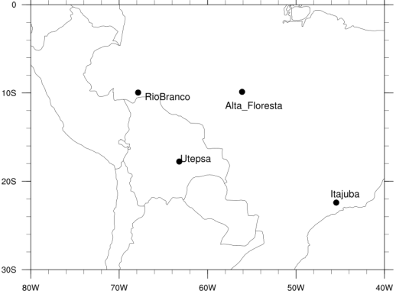
Day 1 AOD forecast verified against AERONET
AERONET stations over S. America
GEFS-Aerosols total AOD prediction matches closely with station data – throughout biomass burning season in S. America

Slide 12
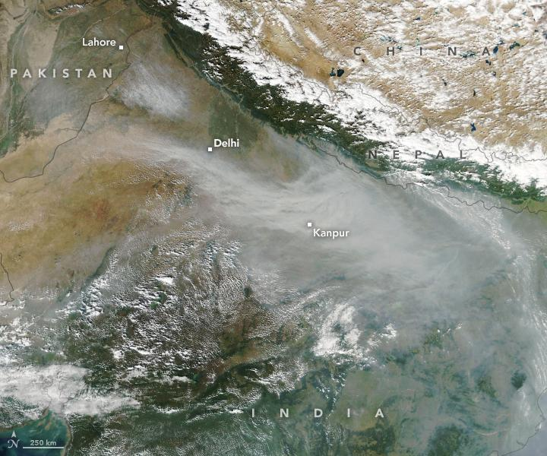
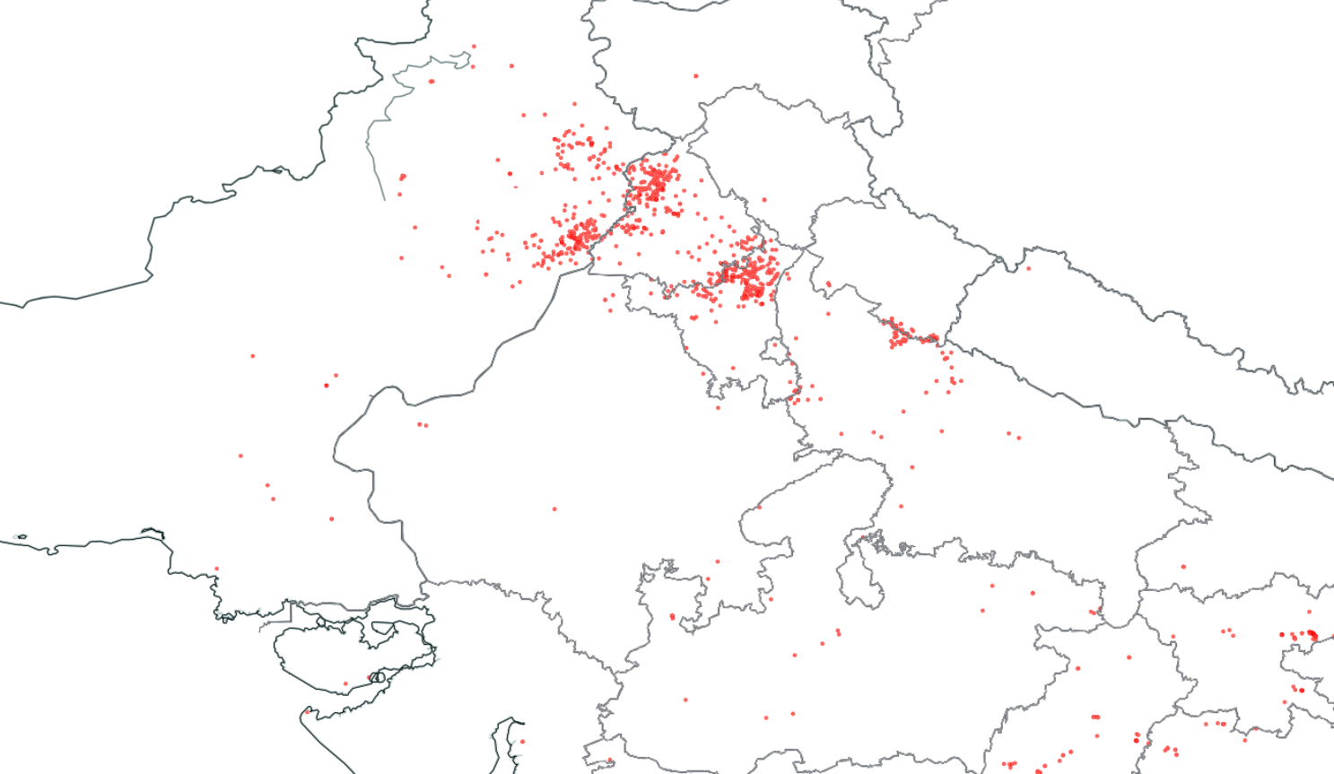
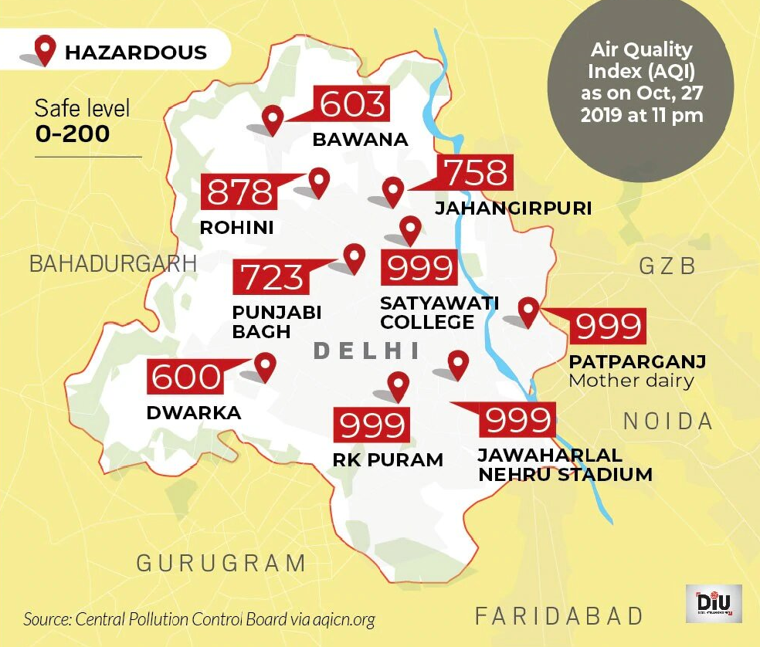
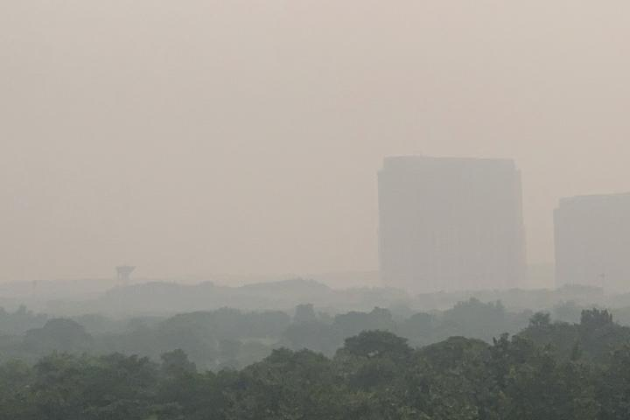
High aerosol event : Agricultural fire and anthropogenic emission over N. India – October-November, 2019
Crop burning : Sumoi NPP Fire and thermal anomalies (15th October, 2019)
Haze over N. India (MODIS true color image) on
4 November
Pollution over Delhi

Slide 13
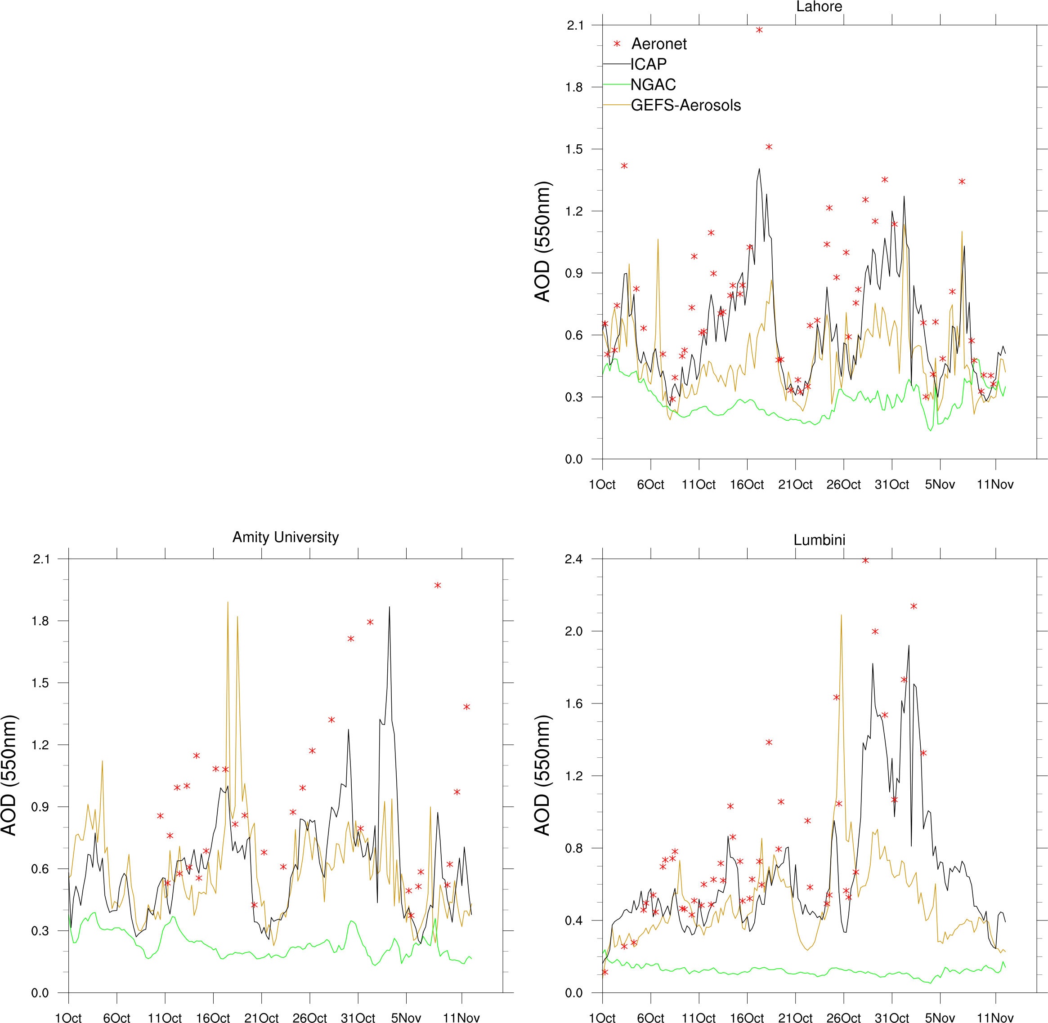
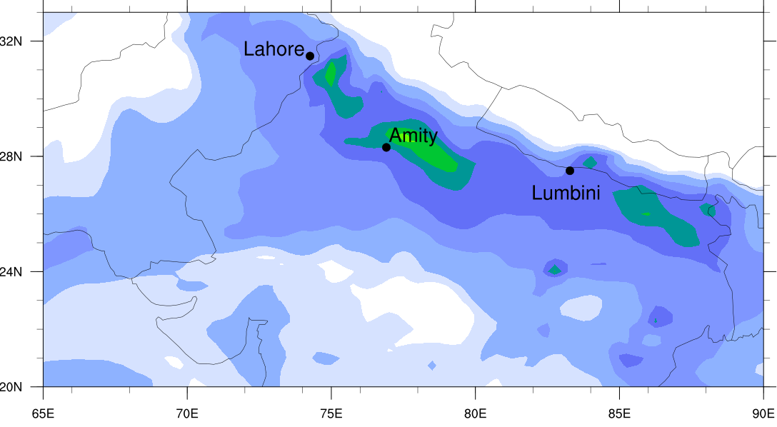
AERONET stations
Crop burning
Day 1 AOD forecast from GEFS-Aerosols show under prediction over Agricultural burning location in NW India and northern Pakistan, but result is better than NGAC

Slide 14
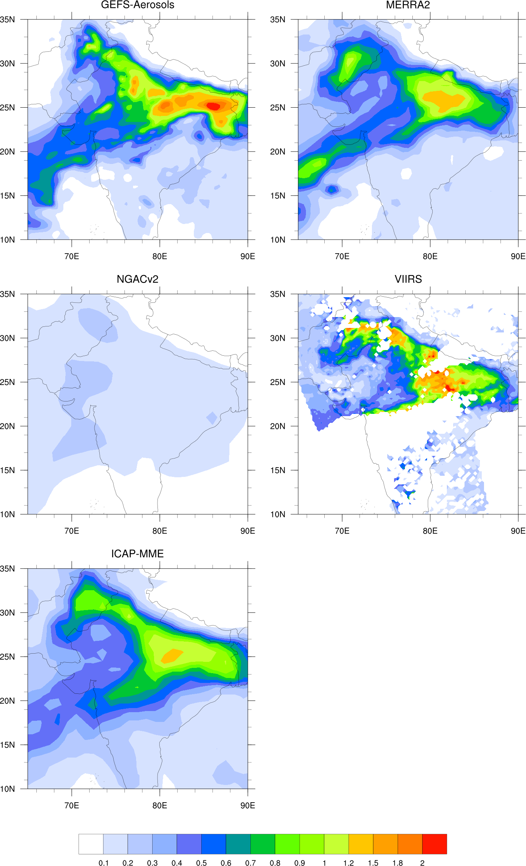
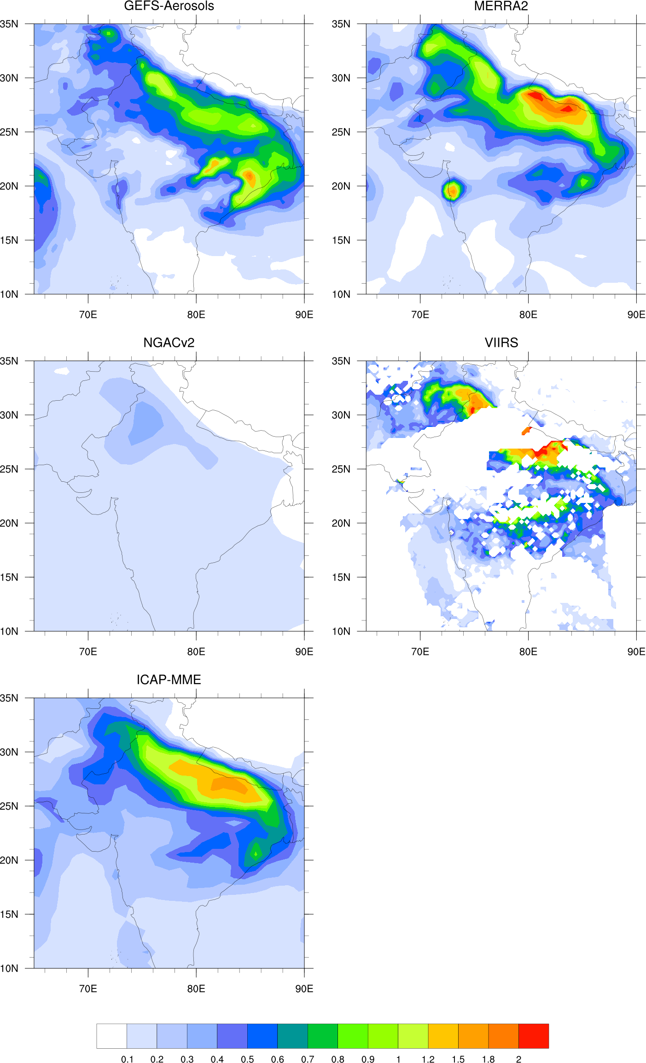
Transport of Total AOD from west to Indo-Gangetic plane during October
Crop burning area
MERRA2 getting high
aerosol right using DA
18-hour forecast on 18th October, 2019
18-hour forecast on 29th October, 2019

Slide 15
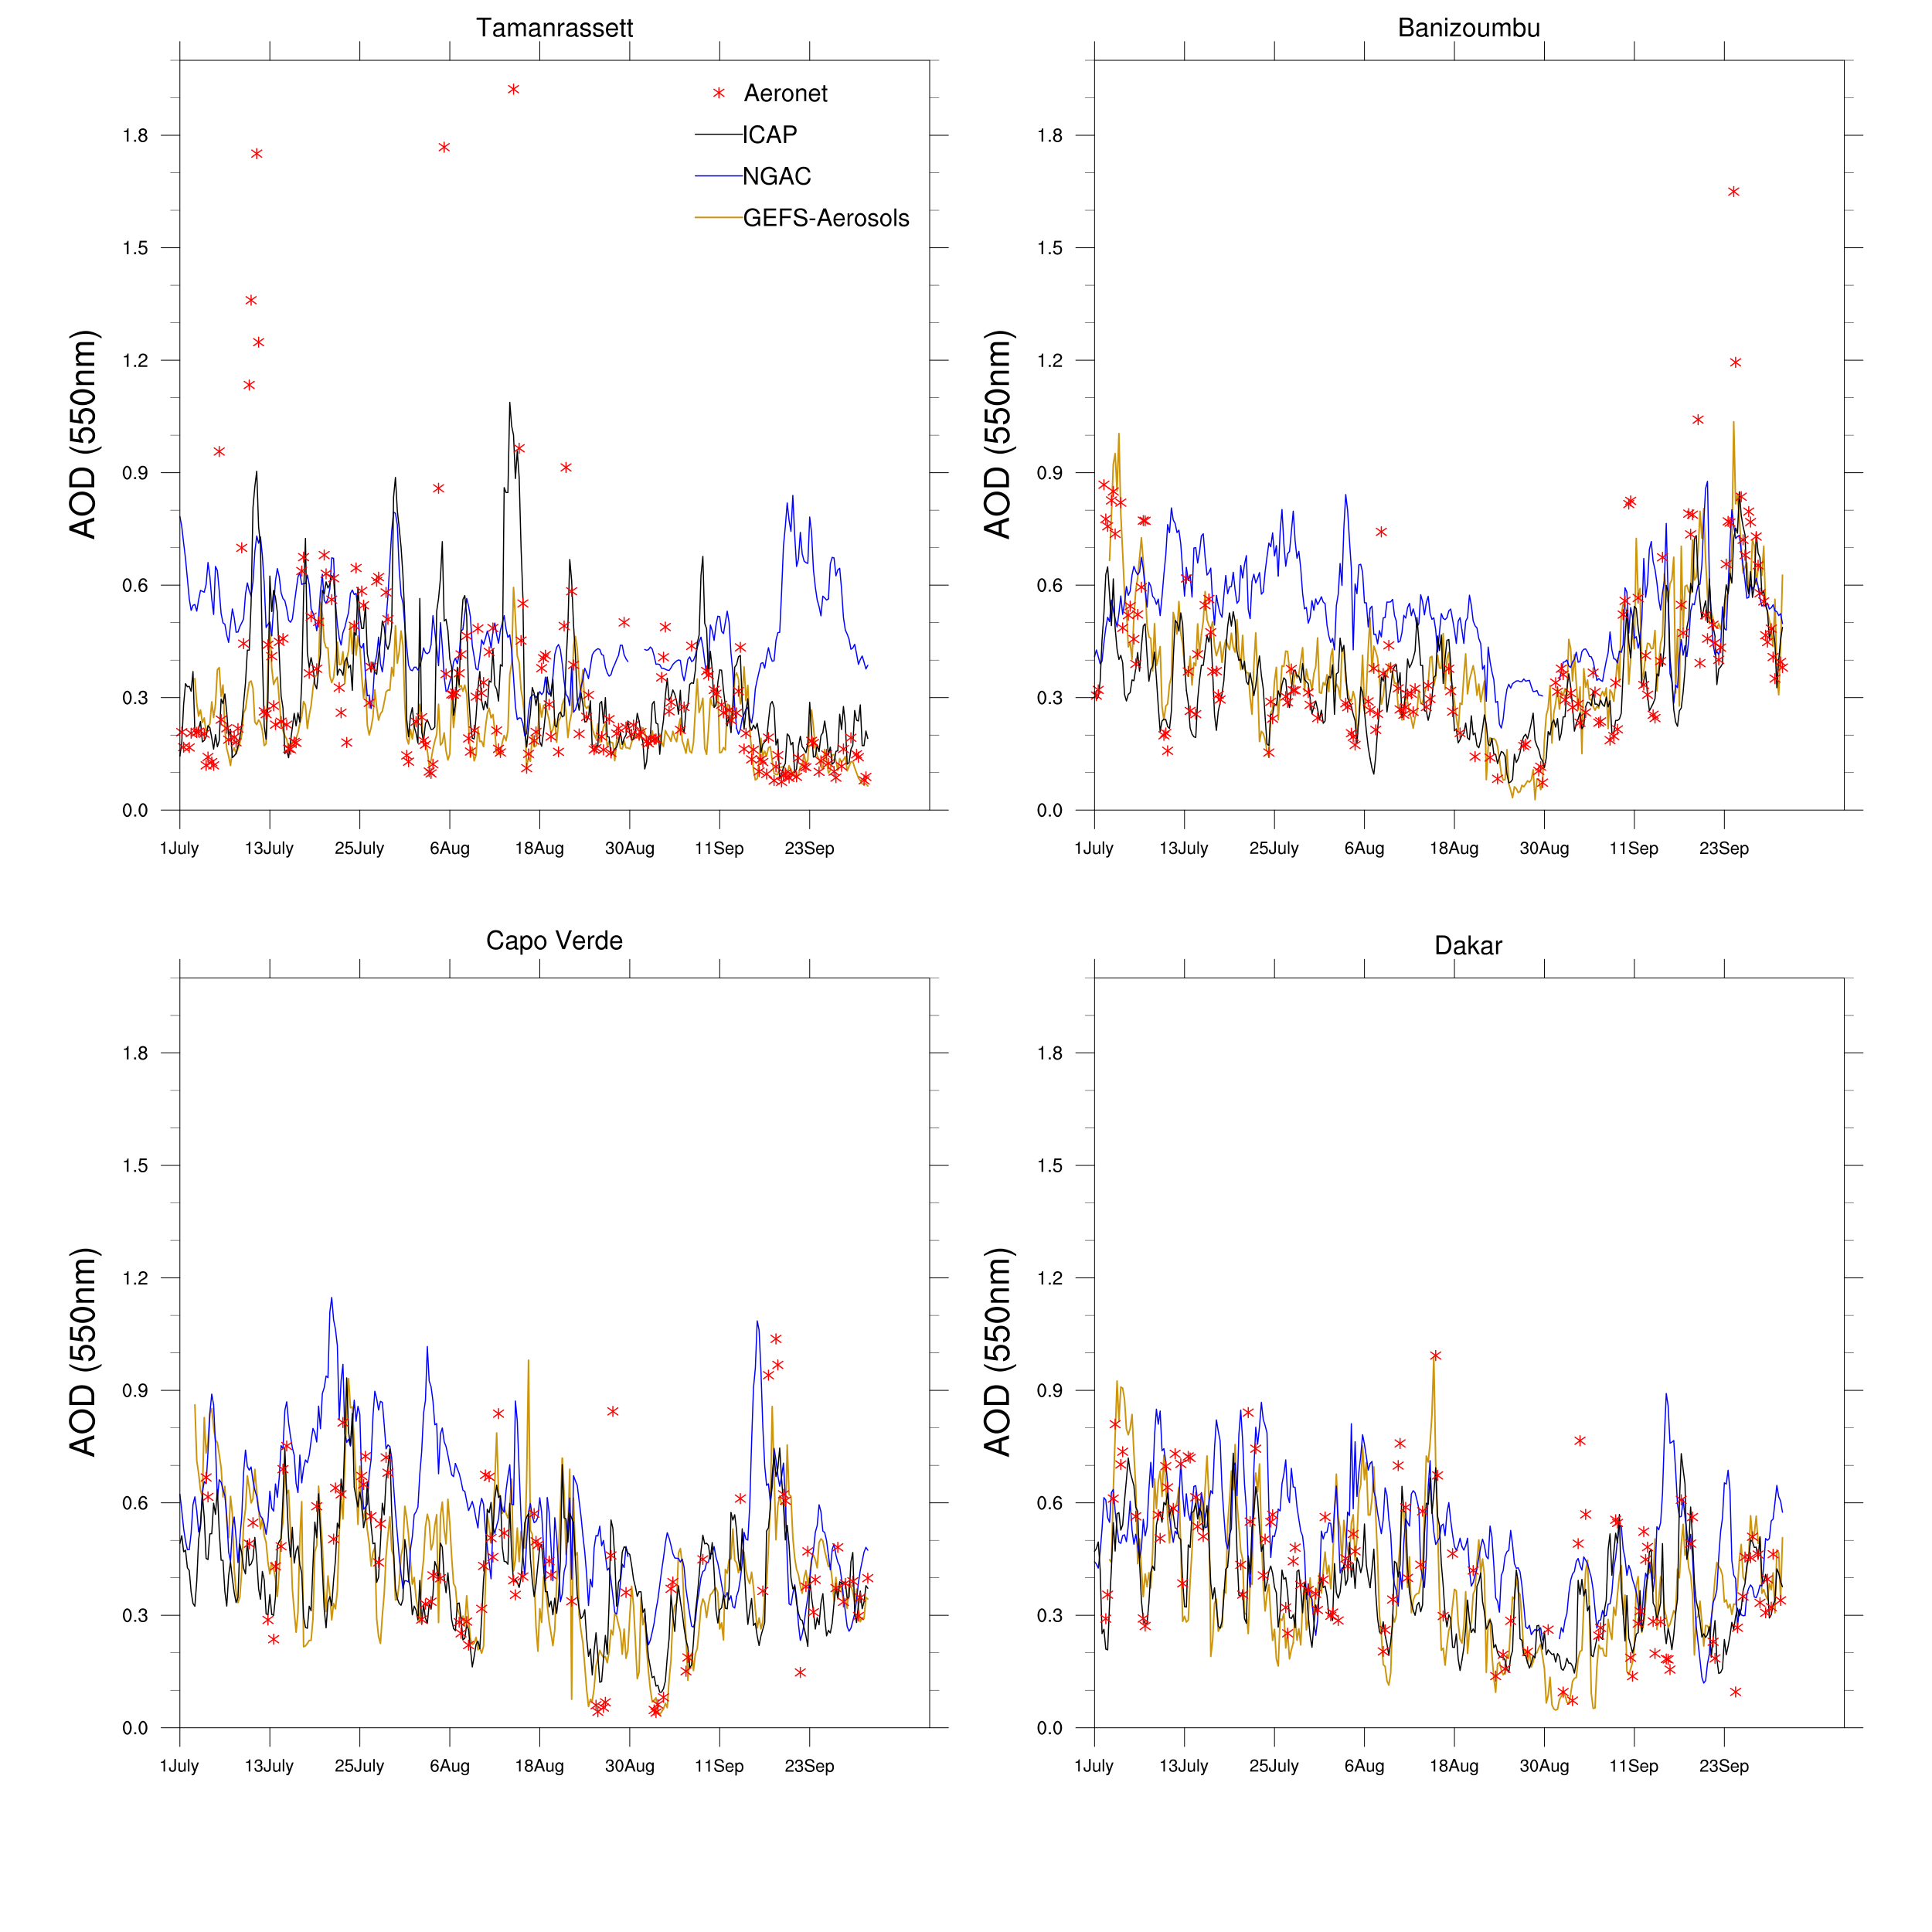
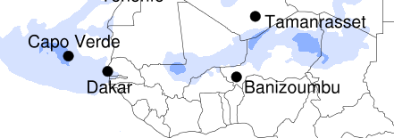
High aerosol event : Saharan Dust
Aeronet locations over Sahara region
Near dust source region (Tamanrassett), GEFS-Aerosols matches closely with the observation
Some under prediction over dust outflow region

Slide 16
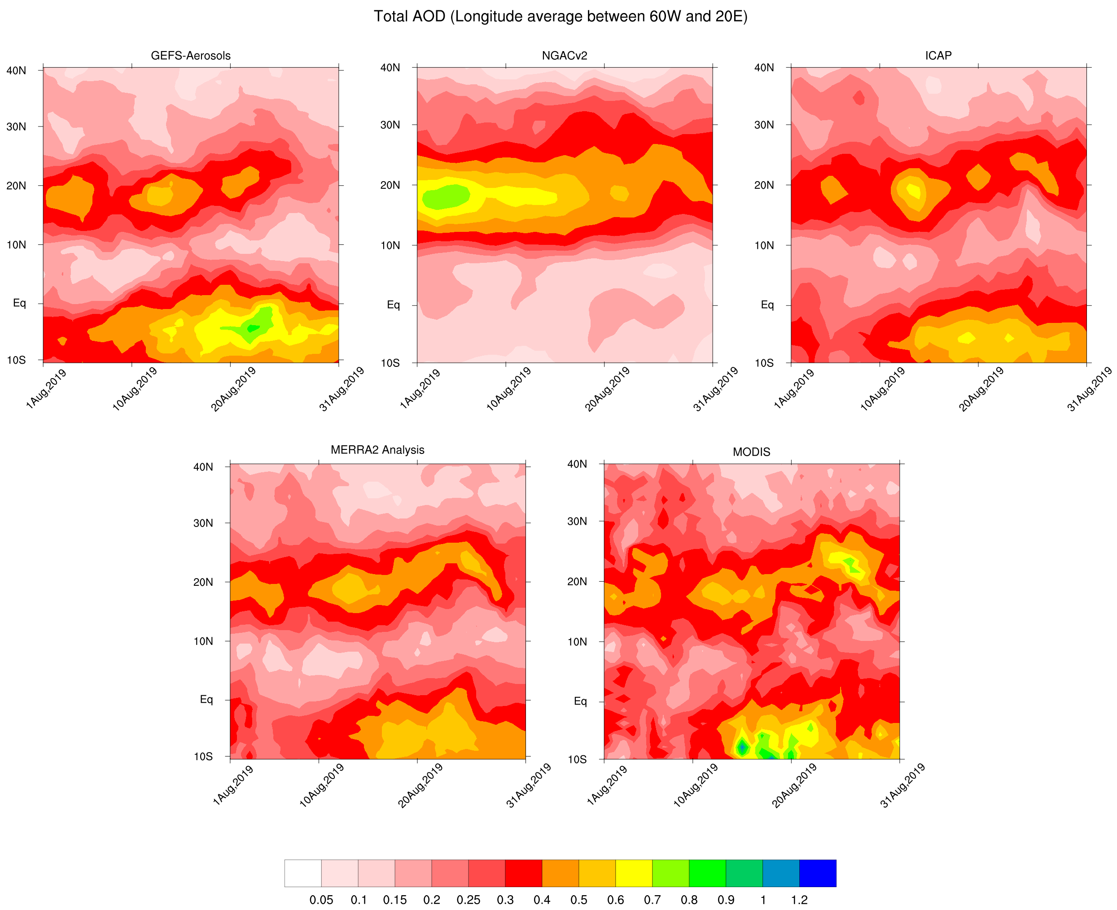
model AOD forecast verified against observations over N. Atlantic :
Transport of dust between 10-30º N from GEFS-Aerosols showed similarity
with observation

Slide 17
Conclusions
GEFS-Aerosols with improved tracer transport, higher resolution, use of plume rise model and GBBEPx emission
showed overall improvement of total AOD forecast than the current operational NGACv2. Overall improvements of bias
(less bias) over Asia, major wildfire regions are noted during this study period.
Both near source and downwind locations of high aerosol events, AOD from GEFS-Aerosols are consistent.
Evaluation of dust aerosol over source and downwind regions indicate good agreement with observation
GEFS-Aerosols able to reproduce total AOD monthly/seasonal variation compared to AERONET, ICAP-MME and
MERRA2 reanalysis over complex terrain over India
Future work
Implement near-real time 3D-VAR (GSI) based data assimilation of MODIS and VIIRS AOD retrievals at 550 nm

